Slide 1
PART & PRINTER CONTROL
Chief : L.T.Duyen
Advisor : N.T.Huong
Developer :N.T.V.Anh
Supporter : N.Hong Van, N.T.T.Vinh

Slide 2
Our Team
♥ E-IT & ABM & ADV group ♥
L.T.Duyen
N.T.V.Anh
N.T.Huong
N.Hong Van
N.T.T.Vinh
Chief
Main PIC
Advisor
Requester
Member

Slide 3
AGENDA
1
2
3
4
5
Background
Rick point
Action
Result
Next plan

Slide 4

Background
Free sample
Free sample
TVP
TVP
Champ
Use for 356 fee !
FA
FA
ERI
DSS

Slide 5
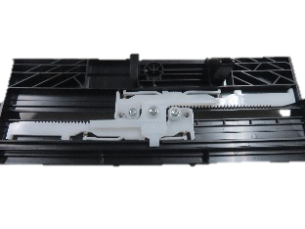
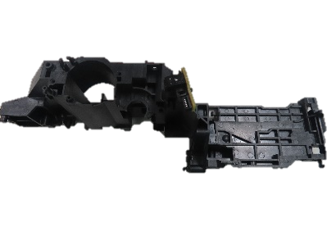
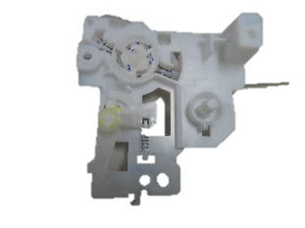
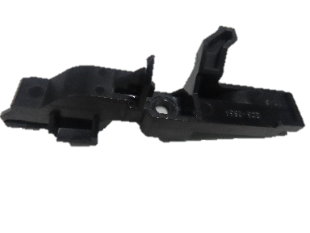


Background
Stats for the year 2020 of all Engineering dep’t !
8054
971
87
596
771
New control
FA
ERI
Champ
DSS
Free Sample
TVP
Workload
Control Discard only!
Manpower

Slide 6


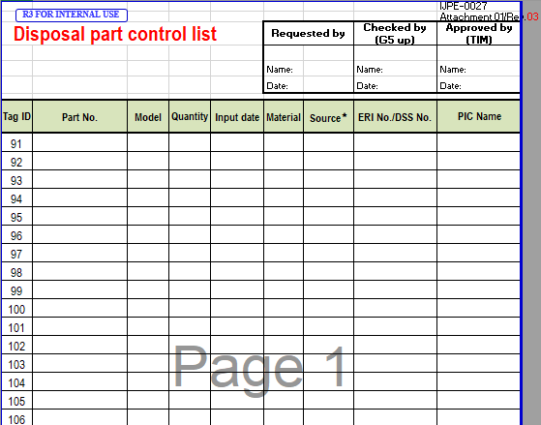

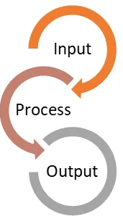


Rick point
Canon Inc. request control 356 fee !
What can we do ?
Accuracy is not guaranteed
Lost and confused
Can not inventory history of Parts
Using the wrong purpose
Must Control
Input and Output !
Huge workload !

Slide 7

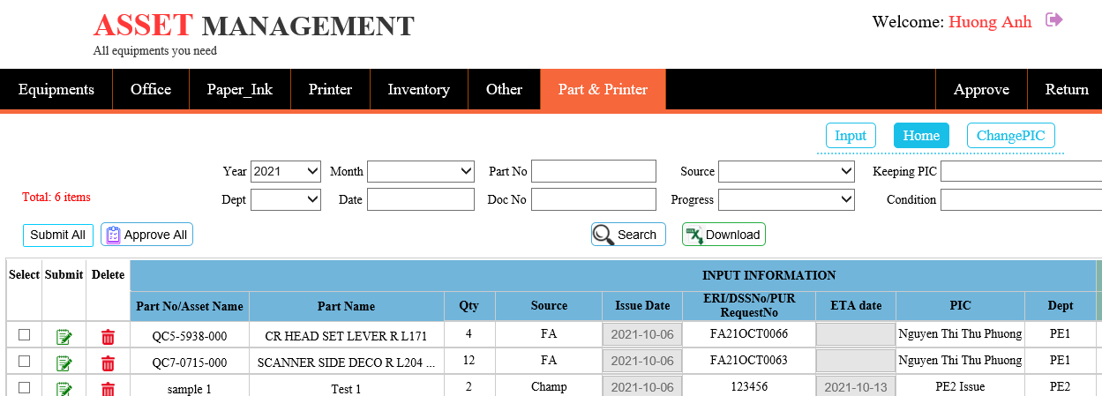
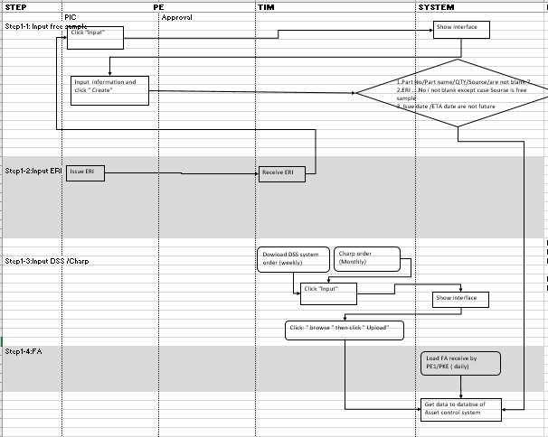
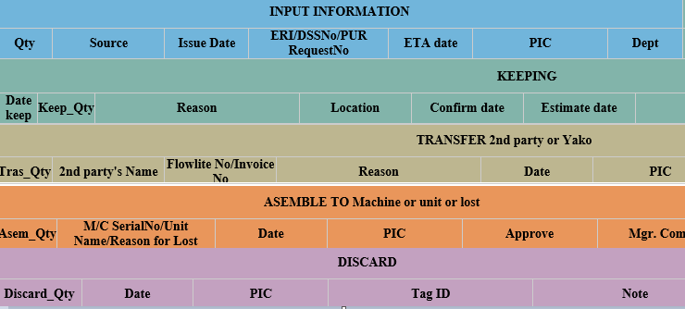
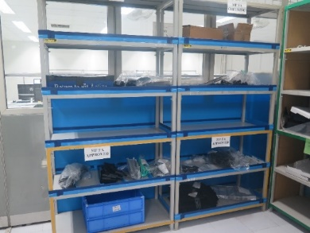
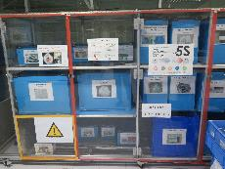

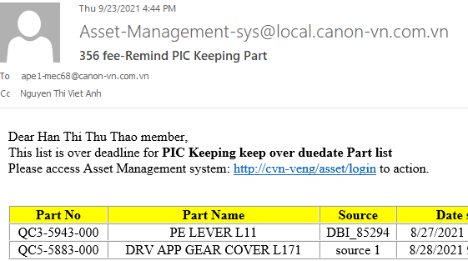

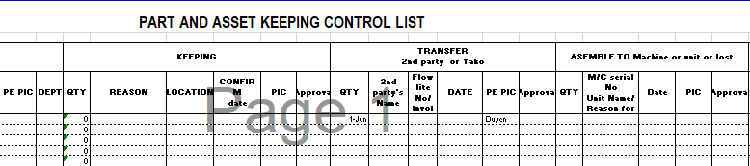
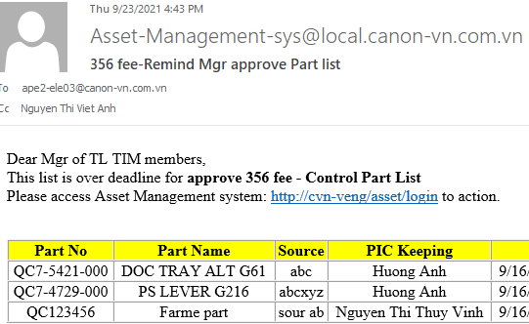
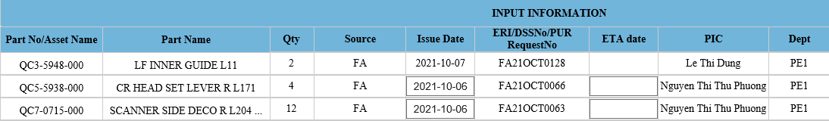
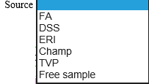
Action
05
04
03
02
01
Risk point !
Hand input all items -> workload huge
Forget input
Mistake: delete file, wrong input, accuracy low
Security: easy lost file
INPUT
Modify layout of the area containing the FA, ERI part and Rubbish area
Excel file control all progress from input to output of Part
Clearly
Fully
Meticulous
Make new procedure control Part by system
Control all Part and Printer in Asset Management system
Clearly
Orderly
Tool auto link data from FA, DSS system and Mail remind PIC and Mgr. over due date

Slide 8

Result
Digital and physical management of all Parts and Printer !
Management
Users
Find data with high speed
Clear user permission
Inventory easier
Add new control Quantity of FA part when TIM receive part
Manage one-part cycle time from Input to Output
Ensure Quantity accuracy of each Part
Job Efficiency
Risk
& confuse

Slide 9
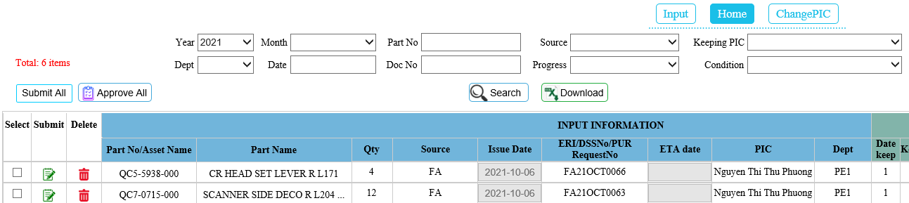
Result
s
01
SIMPLE
M
A
All action for Input Info, Keeping, Transfer, Assemble or Lost, Discard in once time
R
All in one
T
Multi Submit / Approval

Slide 10
Result
s
01
M
MUDA-LESS
A
Auto link data from FA, DSS,ERI system
=> Reduce working time for input items
R
T
FA: 20 minute x 260 working days = 520 minutes = 9 hours/year
DSS: 2 minute x 596 items = 1192 minutes = 20 hours/year
No manual input
ERI: 1.5 minute x 971 items = 1457 minutes = 25 hours/year

Slide 11
Result
s
02
SIMPLE
M
A
All action for Input Info, Keeping, Transfer, Assemble or Lost, Discard in once time
R
All in one
T
Multi Submit / Approval

Slide 12
Result
s
02
M
MUDA-LESS
A
Auto link data from FA, DSS,ERI system
=> Reduce working time for input items
R
T
FA: 20 minute x 260 working days = 520 minutes = 9 hours/year
DSS: 2 minute x 596 items = 1192 minutes = 20 hours/year
No manual input
ERI: 1.5 minute x 971 items = 1457 minutes = 25 hours/year

Slide 13
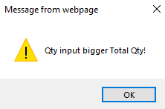
Result
s
03
M
AUTOMATIC
A
Auto calculate Keeping Quantity = Total Qty – Transfer Qty – Assemble or Lost Qty – Discard Qty
* Transfer Qty – Assemble or Lost Qty only calculate after Mgr. approve
R
T
Alert user when input Quantity Transfer + Discard + Assemble or Lost > Total Quantity

Slide 14
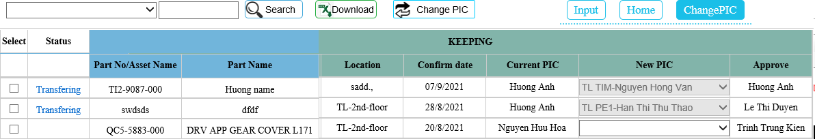
Result
s
04
REALTIME
M
Update current status of Part need change PIC
Link data real time if FA system have data (after 30 minute when ENG dep’t confirm in FA system )
A
R
T

Slide 15
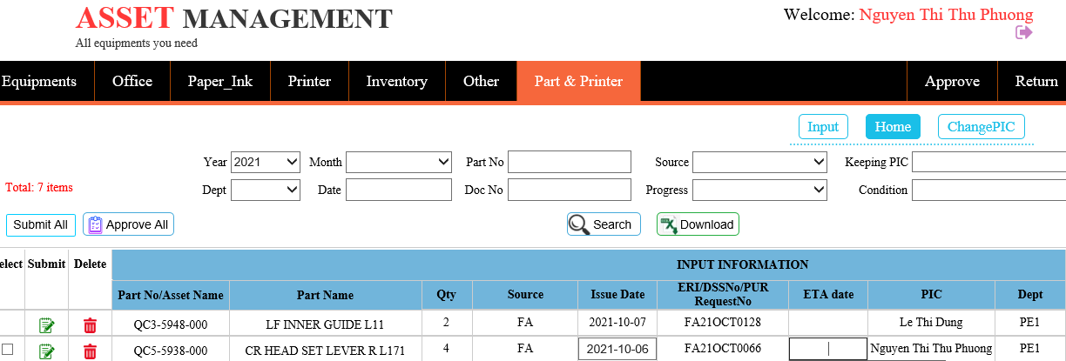
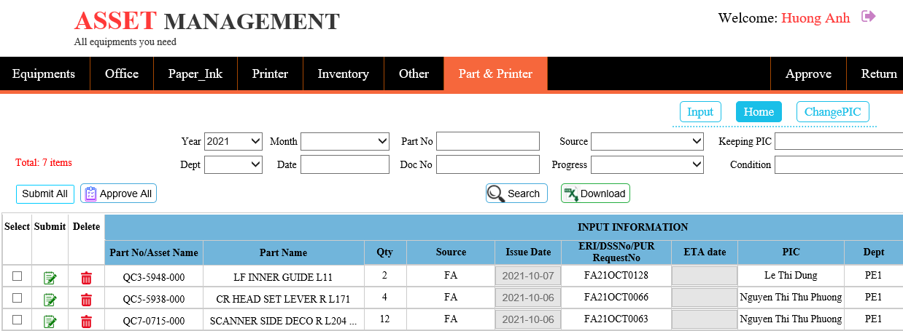
Result
s
05
TROUBLESS
M
A
Authorization only PIC keeping can be submit by disable permission user not be PIC keeping
Prevent wrong, lack of data
R
T

Slide 16

Next plan
03
Expand and share this management method for other DIV
(if need)
Start official running from 18 - Oct - 2021
01
Monitor the effectiveness + absorb user feedback
Trial run system for 2 week (05 Oct – 15 Oct)

Slide 17

Thank you!
Do you have any questions?

